Slide 1
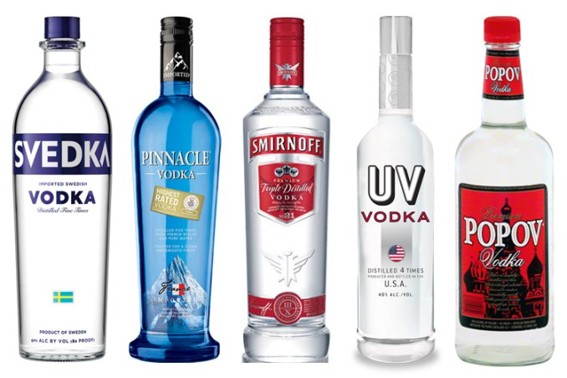
In VODKA We Trust

Slide 2
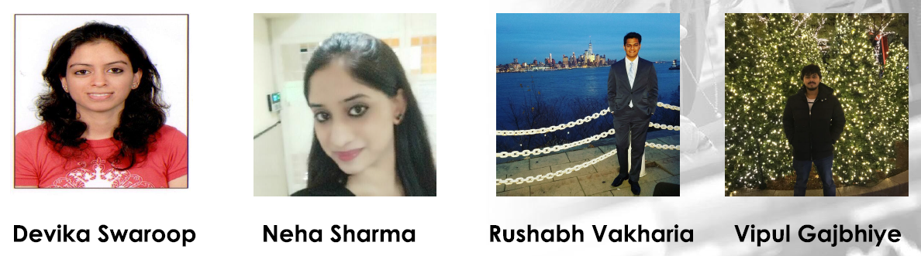
Final project presentation
BIA 672-A
(MARKETING ANALYTICS)
Under the guidance of Prof. Khasha Dehnad
Presented By:
Devika Swaroop Neha Sharma Rushabh Vakharia Vipul Gajbhiye

Slide 3
Objectives/Business needs
Use robust marketing analytic strategies like Clustering, Segmentation, Forecasting, Price elasticity, etc. to:
Provide better ways for liquor stores to make significant profits from vodka sales.
Provide stores entering the liquor market with a platform to compete with existing stores.
Help stores at a nascent stage to concentrate on areas in Iowa where they can boost their sales and branding.
Develop better pricing models for existing and/or new liquor stores.
Help stores target audience with specific demographic attributes and preferences.

Slide 4
Target Market - State of IOWA
Existing retail liquor stores who approach consultants for boosting their sales, profits and customer base
New retail liquor stores who wish to establish a customer base through the opening of a new store

Slide 5
Data Source
The Iowa Department of Commerce requires that every store that sells alcohol in bottled form is required to log every sale of alcohol
This data is published as open data by the State of Iowa and has been republished as-is on Kaggle
The analysis is performed on 414193 rows of data for the period of 2014 to 2017
The dataset contains information on the date of sale, name of the brand, price, quantity, city, number of bottles sold and volume of liquor sold in gallons

Slide 6
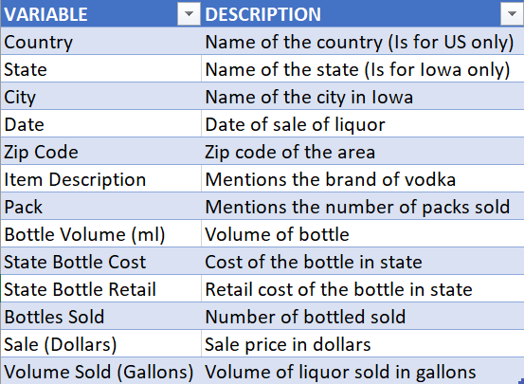
Dataset Variables
Below is a list of all 13 variables in the dataset that we have used for our analysis:

Slide 7
Visualizations
Based on the variables and data described, we have performed marketing analysis on the existing trends of vodka sales of 6 specific brands viz:
Absolut,
Svedka,
Smirnoff,
GreyGoose,
New Amsterdam and
Five O’Clock
in Iowa and provided a few visualizations for the period 2014 to 2017

Slide 8
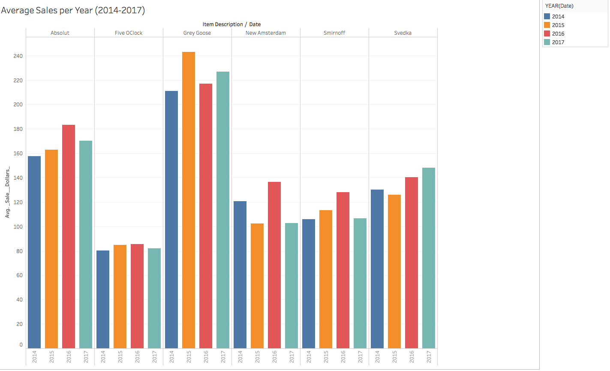
Average sales per year
Key takeaway: This graph shows that Grey Goose has the maximum average sale for each of the years in Iowa followed by Absolut. This shows that Grey Goose is a very popular brand in the state even with it’s high price

Slide 9
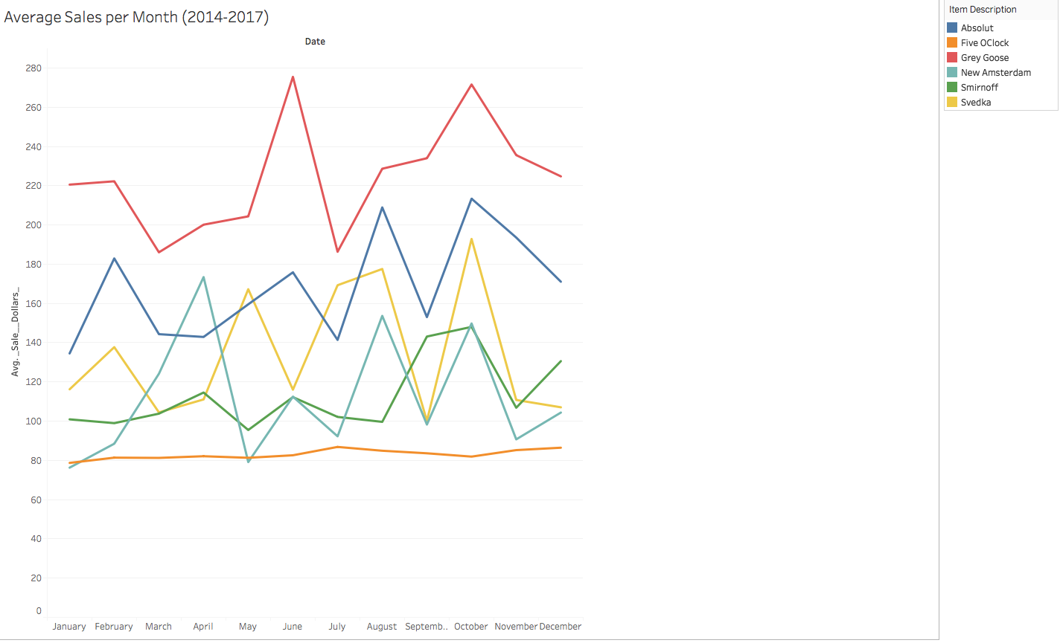
Average sales per month
Key takeaway: In this graph, we see that the sales of brands increase dramatically in the summer with Grey Goose the leader in sales followed by Absolut and Svedka

Slide 10
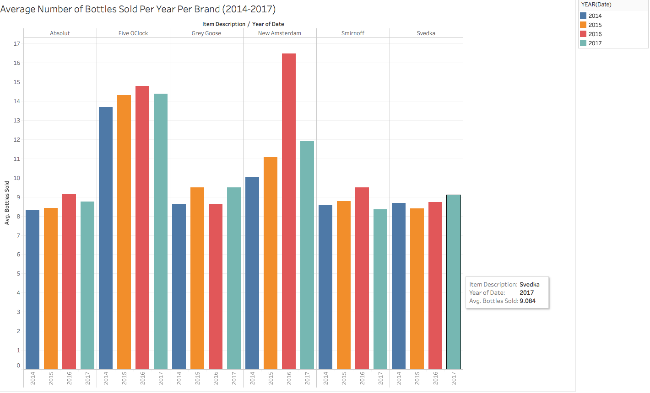
Average number of bottles sold per year per brand
Key takeaway: This graph shows that New Amsterdam is the leader since its price is not as high as compared to other brands. Grey Goose being expensive has less number of bottles sold

Slide 11
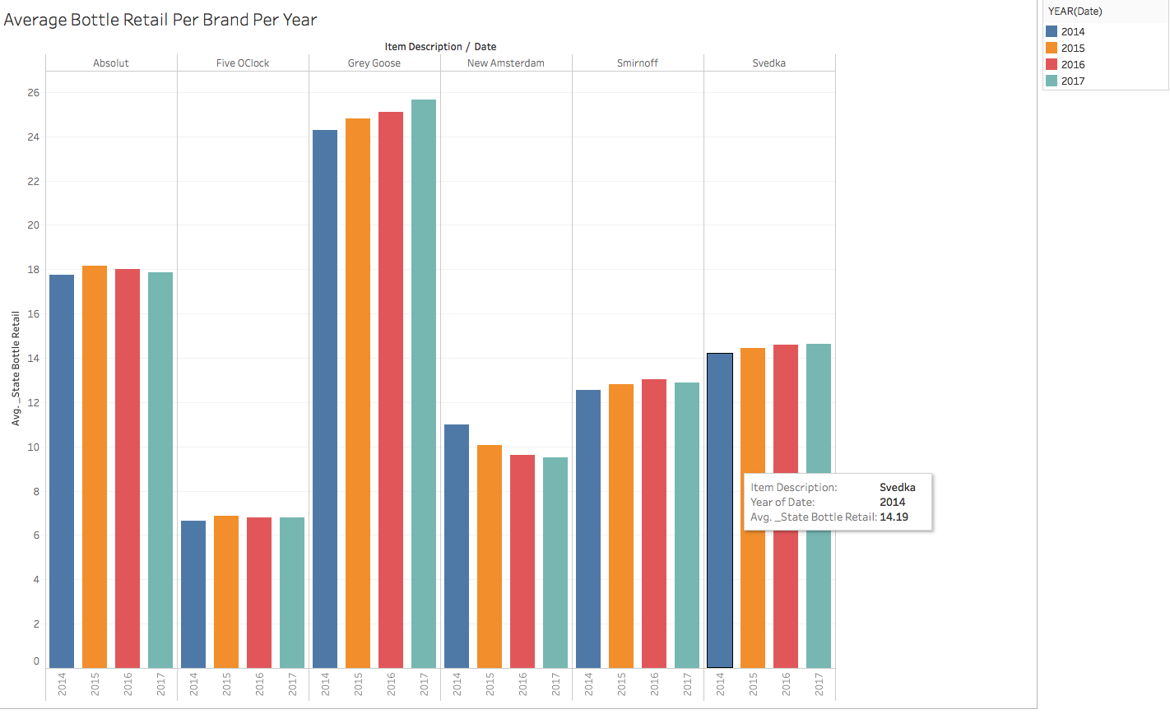
Average bottle retail price per brand per year
Key takeaway: This graph shows us that Grey Goose is the most expensive brand followed by Absolut, Svedka and Smirnoff

Slide 12
Price elasticity model
Price elasticity refers to the market demand of a product in comparison to changing prices. Factors affecting price elasticity include customer, product, competition, etc.
Here, we have taken log price elasticity for each of the 6 vodka brands and analyzed whether their prices indicate a growth or decline in sales.
This will help vodka retailers stay ahead of competition and market fluctuations by optimizing pricing and segmenting products.

Slide 13
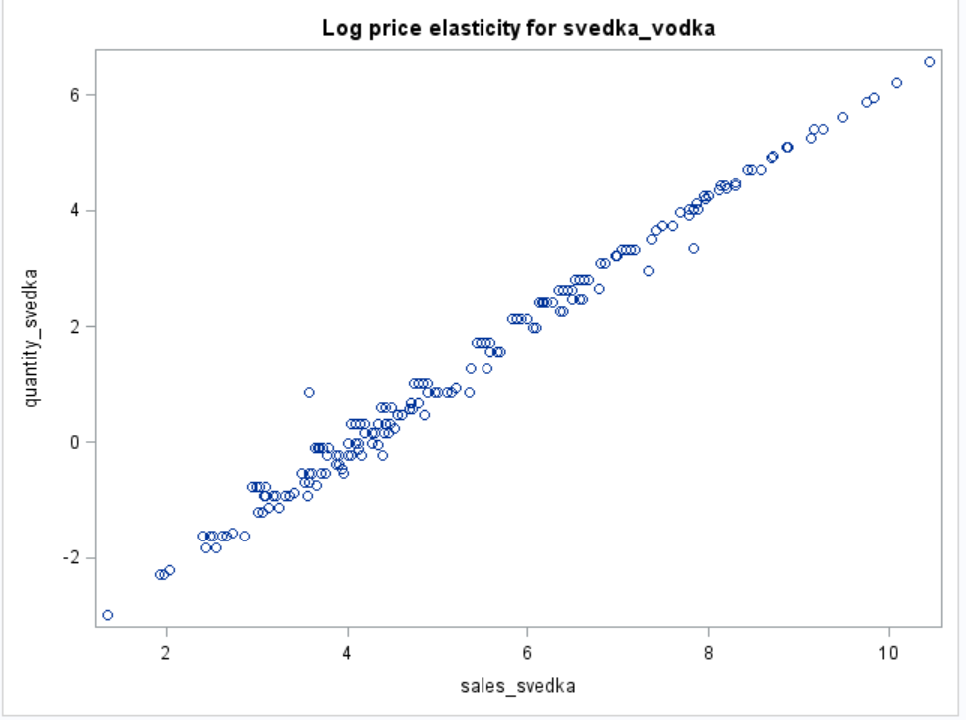
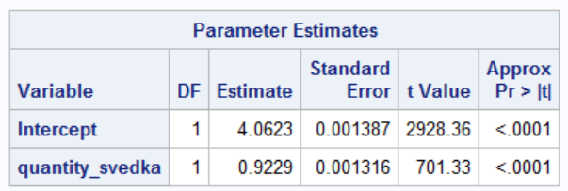
Price Elasticity for Svedka vodka

Slide 14
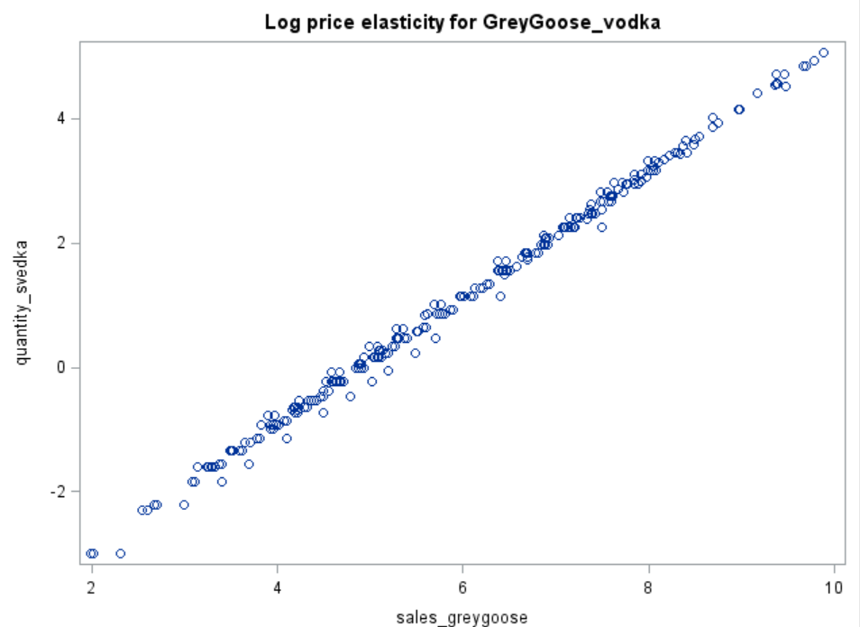
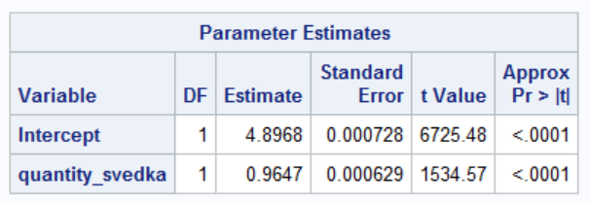
Price Elasticity for GreyGoose vodka
quantity_grey

Slide 15
Forecasting
In order to help the liquor stores estimate sales of specific brands for the next 1 year, we have made use of 2 forecasting methods viz
1. Single exponential smoothing
2. Seasonal exponential smoothing
On comparing the MAPE (Mean Absolute Percentage Error) values of the 2 methods, we found that Seasonal Exponential Smoothing works the best for all brands

Slide 16
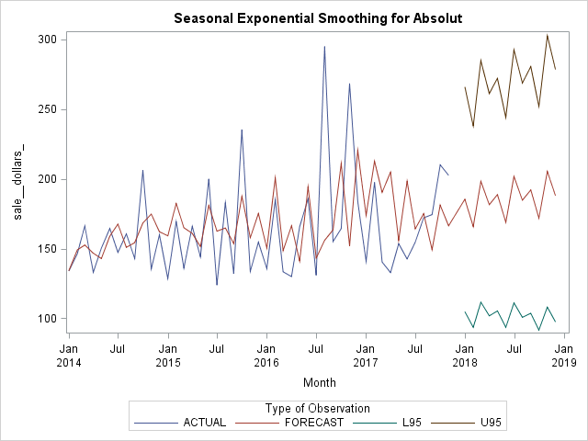
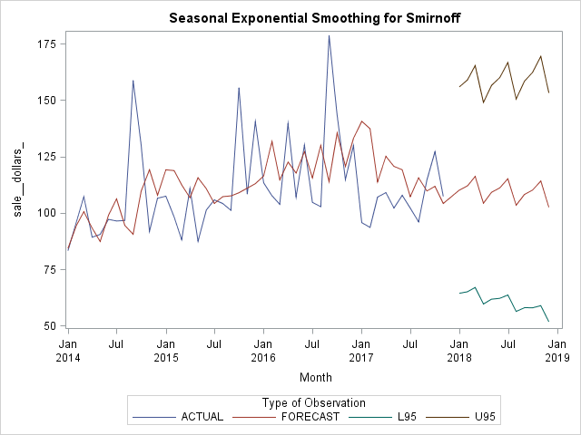
Seasonal Exponential Smoothing for Absolut and Smirnoff

Slide 17
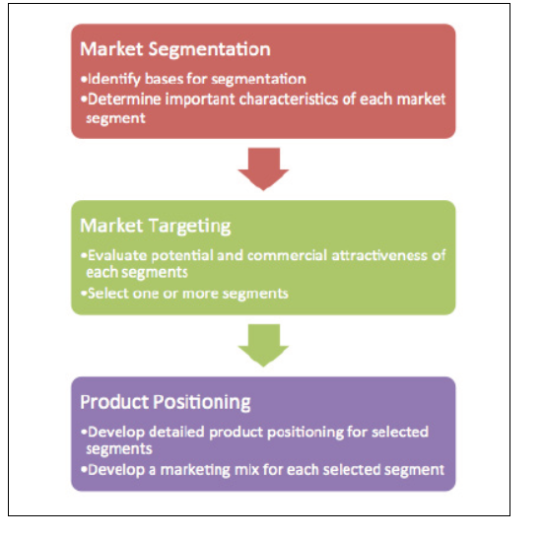
Clustering/Segmentation
How Clustering helps to segment the market for analysis?

Slide 18
Customer preference of vodka on the basis of demographics
Age Group | Income | Vodka preference
21-34 | 50k and above | Grey Goose/Absolute
21-34 | 30 - 50k | Svedka/Smirnoff
35-64 | 50k and above | Grey Goose/Absolute/Smirnoff
35-64 | 30-50k | New Amsterdam/Svedka
65 and above | 50-100k | FiveOClock/Absolut/Svedka

Slide 19
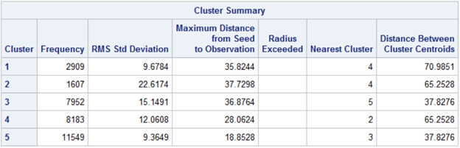
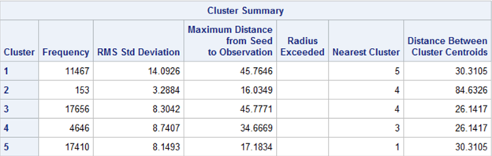
Market segmentation based on 5 clusters for each vodka brand
Absolut:
Smirnoff:

Slide 20
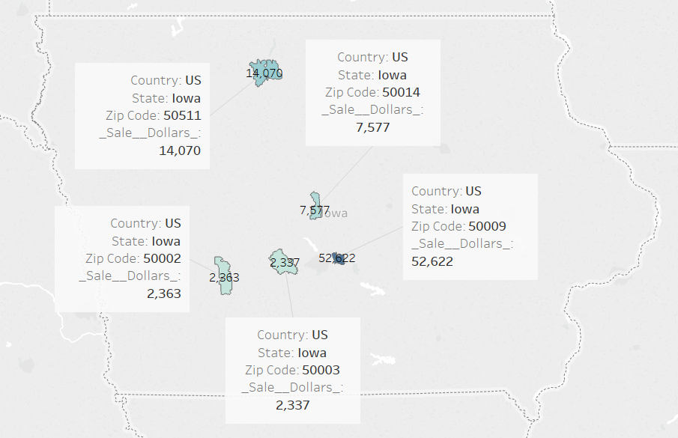
Demographics showing areas with maximum sales for Absolut

Slide 21
Marketing Strategy
Our main strategy for marketing is based on factors like :
Age Group
Income
Zip Code
Our plan is to target a certain age group in a specific zip code to increase the vodka sales for a new or existing vodka retail store that wants to :
Decide on the inventory of vodka that the stores should keep in order to serve maximum customers
Keep holding costs in check while maintaining sufficient stock
Example: For the zip code 50002 in the state of Iowa,
Age group 21-34 prefer brands like Absolut and Greygoose with income above 50k compared to income below 50k as they prefer Svedka and Absolut

Slide 22
References:
Kaggle
Claritas

Slide 23
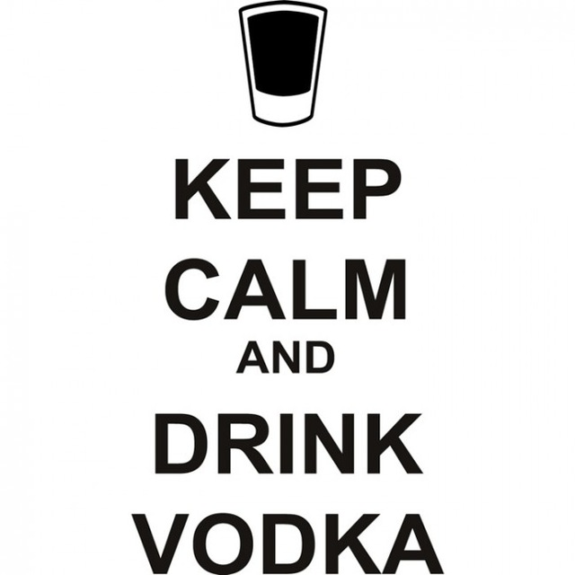
THANK YOU!!

